Slide 1

Advances of Machine Learning in Finance: OLS and LASSO regressions in R
Hadi Movaghari
2022-2023

Slide 2
Outline
Section 1: An introduction to R programming
Section 2: LASSO theory
Section 3: The packages
Section 4: Example 1: Artificial Data
Section 5: Example 2: An application in finance
Advances of Machine Learning in Finance: OLS and LASSO regressions in R
University of Glasgow
2022-2023

Slide 3

Section 1: An introduction to R programming

Slide 4
Useful links
To download the latest version of R see https://cloud.r-project.org/
To see a complete list of available packages in R see https://cloud.r-project.org/web/packages/available_packages_by_name.html
A comprehensive list of packages by topics https://cloud.r-project.org/web/views/
The specific page for machine learning packages https://cloud.r-project.org/web/views/MachineLearning.html
Advances of Machine Learning in Finance: OLS and LASSO regressions in R
University of Glasgow
2022-2023

Slide 5
How can I use an R package?
Step 1
Installing
install.packages(“package’s name")
Step 2
Loading
library(package’s name)
Advances of Machine Learning in Finance: OLS and LASSO regressions in R
University of Glasgow
2022-2023

Slide 6
Preliminaries
Basic operators in R
+ | - | / | * | ^ | : | ! | ==
sum | subtraction | division | multiplication | Exponentiation | producing sequence numbers | Not | equal to
Important built-in functions in R
sqrt | log | min | max | mean | sd | abs | sum
Square root | Logarithm | Minimum | Maximum | Average | SD. | Absolute value | Summation
Advances of Machine Learning in Finance: OLS and LASSO regressions in R
University of Glasgow
2022-2023

Slide 7
Objects in R
Vector
> c(1,2,3)
[1] 1 2 3
Matrix
> matrix(c(2,5,1,7), ncol=2)
[,1] [,2]
[1,] 2 1
[2,] 5 7
Data frame
> data.frame(x1=1:3, x2=2:4)
x1 x2
1 1 2
2 2 3
3 3 4
Advances of Machine Learning in Finance: OLS and LASSO regressions in R
University of Glasgow
2022-2023

Slide 8
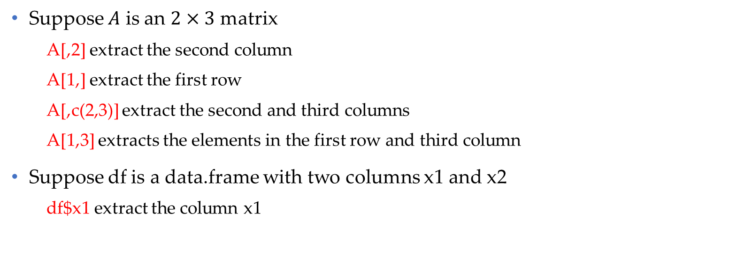
Objects in R (Cont’d)
Suppose $A$ is an $2×3$ matrix
A[,2] extract the second column
A[1,] extract the first row
A[,c(2,3)] extract the second and third columns
A[1,3] extracts the elements in the first row and third column
Suppose df is a data.frame with two columns x1 and x2
df$x1 extract the column x1
Advances of Machine Learning in Finance: OLS and LASSO regressions in R
University of Glasgow
2022-2023

Slide 9
Importing data into R
from Excel file
library("readxl")
mydata <- read_excel(“path of the file/file name.xlsx")
from CSV file
mydata <- read.csv(“path of the file/file name.csv")
from Stata file
library(“readstata13”)
mydata <- read.dta13(" path of the file/file name.dta")
Advances of Machine Learning in Finance: OLS and LASSO regressions in R
University of Glasgow
2022-2023

Slide 10
Some useful functions
Sequence of numbers
seq(from=2, to=10, by=3)
[1] 2 5 8
Repeating elements
rep(c("a", "b"), each=3)
[1] "a" "a" "a" "b" "b" "b"
Advances of Machine Learning in Finance: OLS and LASSO regressions in R
University of Glasgow
2022-2023

Slide 11
Writing a statistical model
To write a statistical mode use operator ~ in the following way:
dependent ~ independent1 + independent2
Use -1 to remove the intercept term from the model
dependent ~ independent1 + independent2 - 1
Advances of Machine Learning in Finance: OLS and LASSO regressions in R
University of Glasgow
2022-2023

Slide 12
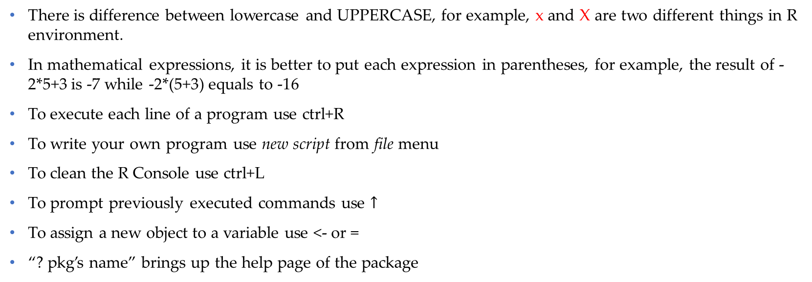
Other tips!
There is difference between lowercase and UPPERCASE, for example, x and X are two different things in R environment.
In mathematical expressions, it is better to put each expression in parentheses, for example, the result of -2*5+3 is -7 while -2*(5+3) equals to -16
To execute each line of a program use ctrl+R
To write your own program use new script from file menu
To clean the R Console use ctrl+L
To prompt previously executed commands use $↑$
To assign a new object to a variable use <- or =
“? pkg’s name” brings up the help page of the package
Advances of Machine Learning in Finance: OLS and LASSO regressions in R
University of Glasgow
2022-2023

Slide 13
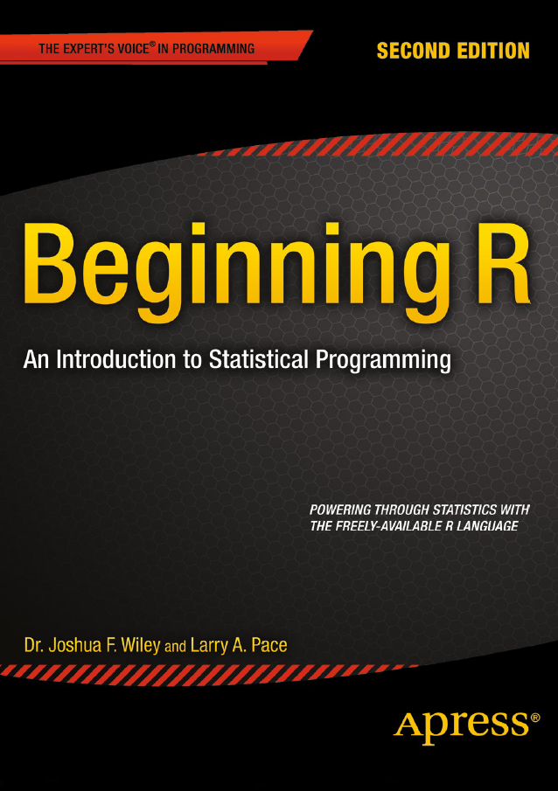


Textbooks for R beginners
Available in the library
Available in the library
Advances of Machine Learning in Finance: OLS and LASSO regressions in R
University of Glasgow
2022-2023

Slide 14
Section 2: LASSO theory

Slide 15
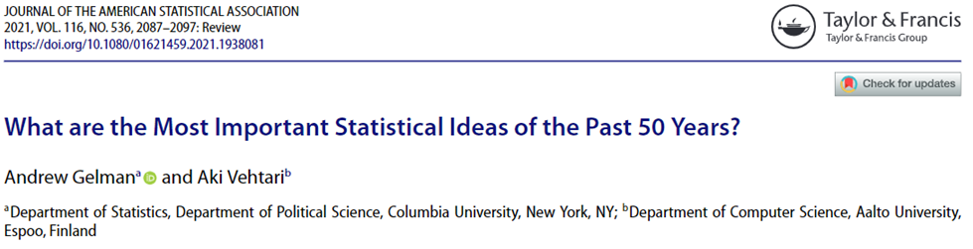
The importance…
One out of ten most important statistical ideas of the past 50 years
(Gelman & Vehtari, 2021)
Advances of Machine Learning in Finance: OLS and LASSO regressions in R
University of Glasgow
2022-2023

Slide 16
The origin
Least Absolute Shrinkage and Selection Operator (LASSO) is a method for variable selection in regression analysis
LASSO is developed by Tibshirani (1996), originally based on the idea in ridge regression of Hoerl and Kennard (1970)
The LASSO has created a broad class of variables election methods called: penalized variable selection
Advances of Machine Learning in Finance: OLS and LASSO regressions in R
University of Glasgow
2022-2023

Slide 17
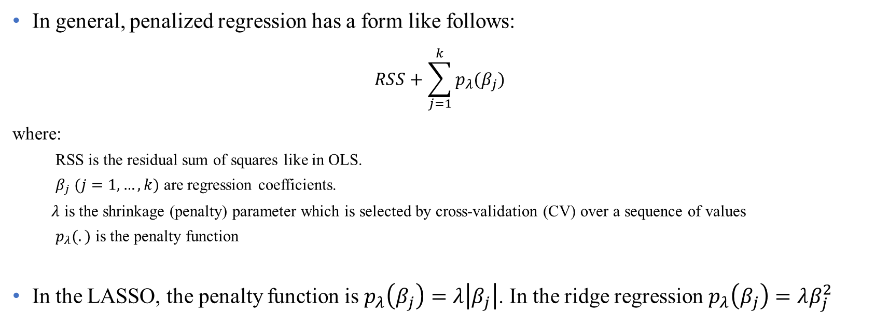
LASSO regression
In general, penalized regression has a form like follows:
$$RSS+\sum_{j=1}^{k}{p_{λ}(β_{j})}$$
where:
RSS is the residual sum of squares like in OLS.
$β_{j} (j=1,…,k)$ are regression coefficients.
$λ$ is the shrinkage (penalty) parameter which is selected by cross-validation (CV) over a sequence of values
$p_{λ}(.)$ is the penalty function
In the LASSO, the penalty function is $p_{λ}\left(β_{j}\right)=λ\left|β_{j}\right|$. In the ridge regression $p_{λ}\left(β_{j}\right)=λβ_{j}^{2}$
Advances of Machine Learning in Finance: OLS and LASSO regressions in R
University of Glasgow
2022-2023

Slide 18
LASSO regression (Cont’d)
Generalizations of the LASSO
Bridge regression (Fu, 1998)
SCAD (Fan & Li, 2001)
Elastic Net (Zou & Hastie, 2005)
Fused LASSO (Tibshirani, et al., 2005)
Group LASSO (Yuan & Lin, 2006)
Adaptive LASSO (Zou, 2006)
For a complete review, see Hastie et al. (2015)
Advances of Machine Learning in Finance: OLS and LASSO regressions in R
University of Glasgow
2022-2023

Slide 19

Q1:
LASSO regression is a supervised or unsupervised machine learning method?
Q2:
The LASSO penalty function, can be used with other loss functions, rather than RSS?

Slide 20

Section 3: The packages

Slide 21
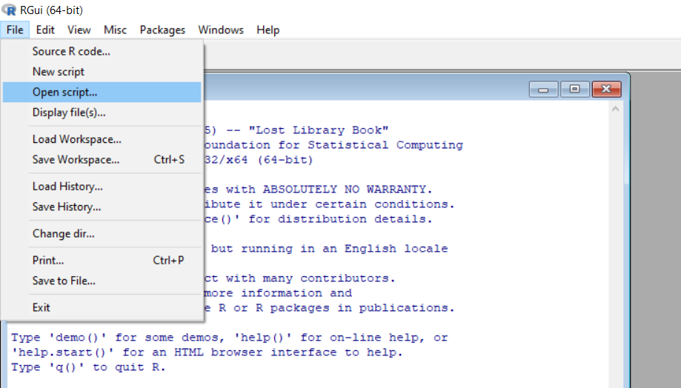
Open your script file!
Download files (script, data, PowerPoint) from Moodle or https://github.com/hadigilan/AdvMLFinance_LASSO.git
From File -> Open script find your file and then open
Advances of Machine Learning in Finance: OLS and LASSO regressions in R
University of Glasgow
2022-2023

Slide 22
R packages for LASSO
There are different R packages to conduct LASSO regression using different algorithm, like:
lassoshooting which utilize shooting algorithm of Fu (1998)
lars which utilizes least angle regression of Efron et al. (2004)
glmnet which utilizes cyclical coordinate descent algorithm of Friedman et al. (2010)
We use the package glmnet, perhaps the most powerful R package for LASSO regression
For detailed applications of glmnet, see James et al. (2017)
Advances of Machine Learning in Finance: OLS and LASSO regressions in R
University of Glasgow
2022-2023

Slide 23
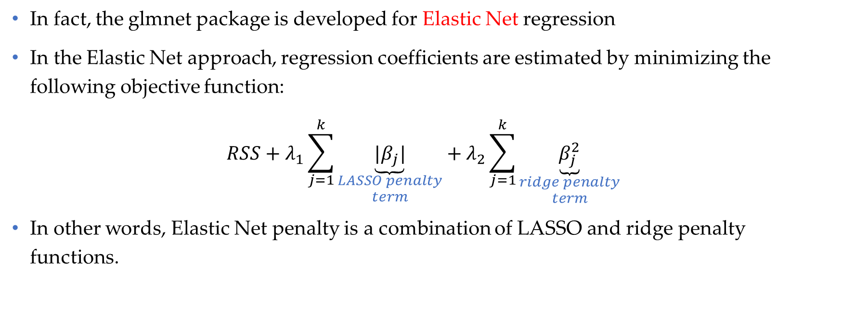
glmnet package
In fact, the glmnet package is developed for Elastic Net regression
In the Elastic Net approach, regression coefficients are estimated by minimizing the following objective function:
$$RSS+λ_{1}\sum_{j=1}^{k}{\underset{\begin{aligned}LASSO penalty \\ term\end{aligned}}{\underbrace{|β_{j}|}}}+λ_{2}\sum_{j=1}^{k}{\underset{\begin{aligned}ridge penalty \\ term\end{aligned}}{\underbrace{β_{j}^{2}}}}$$
In other words, Elastic Net penalty is a combination of LASSO and ridge penalty functions.
Advances of Machine Learning in Finance: OLS and LASSO regressions in R
University of Glasgow
2022-2023

Slide 24
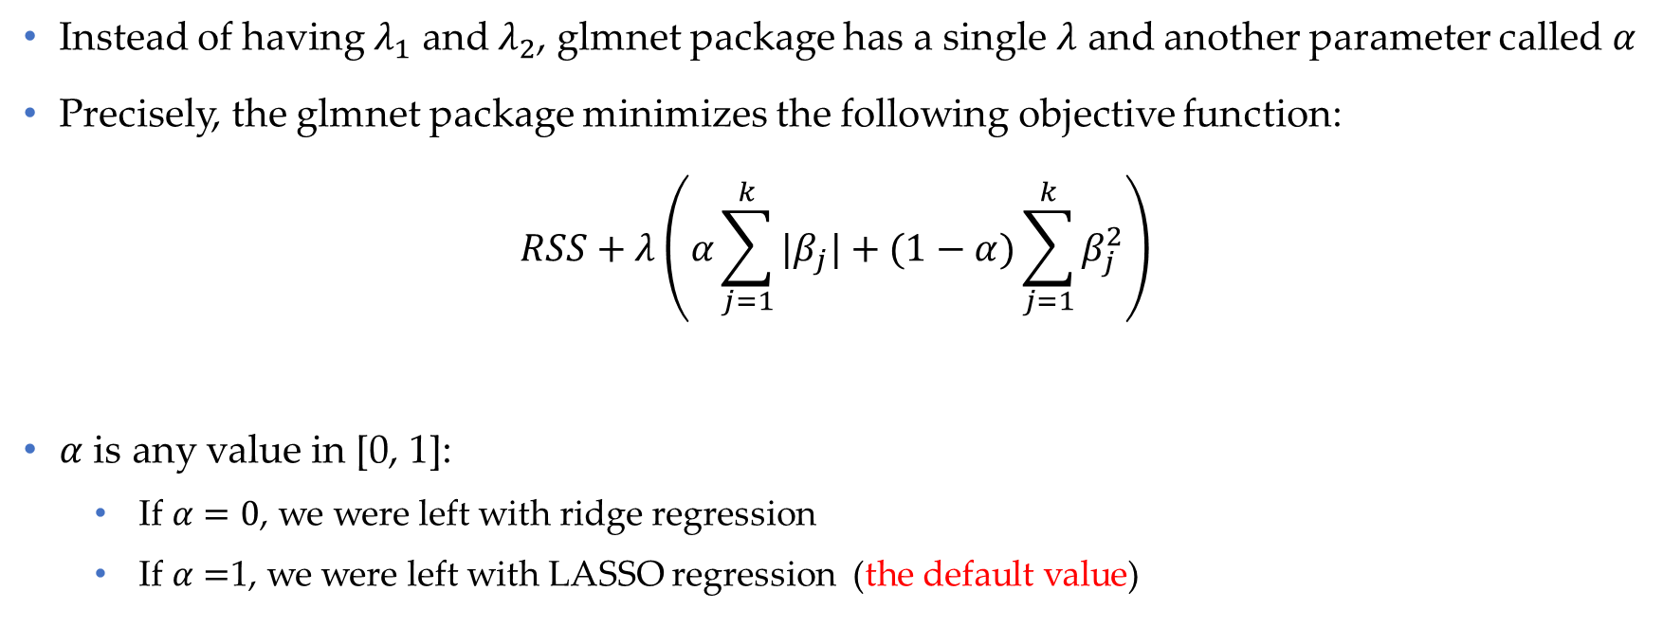
glmnet package (Cont’d)
Instead of having $λ_{1}$ and $λ_{2}$, glmnet package has a single $λ$ and another parameter called $α$
Precisely, the glmnet package minimizes the following objective function:
$$RSS+λ\left(α\sum_{j=1}^{k}{|β_{j}|}+(1−α)\sum_{j=1}^{k}{β_{j}^{2}}\right)$$
$α$ is any value in [0, 1]:
If $α=0$, we were left with ridge regression
If $α=$1, we were left with LASSO regression (the default value)
Advances of Machine Learning in Finance: OLS and LASSO regressions in R
University of Glasgow
2022-2023

Slide 25

glmnet package (Cont’d)
$λ$ controls how much of the penalty to apply.
The higher value of lambda, the sparser model
Sparse model: A model with large number of zero coefficients
$λ=0$ is equivalent to OLS regression
Advances of Machine Learning in Finance: OLS and LASSO regressions in R
University of Glasgow
2022-2023

Slide 26
glmnet package (Cont’d)
The main functions in the glmnet package is glmnet and cv.glmnet with the following main arguments:
x
A matrix containing independent variables
y
A vector containing response variable
A value or a sequence of values for shrinkage parameter (i.e., $λ$)
A value or a sequence of values for shrinkage parameter (i.e., 𝜆)
lambda
A value ($α$) between 0 and 1 which creates a trade-off between LASSO and ridge regression
A value (𝛼) between 0 and 1 which creates a trade-off between LASSO and ridge regression
alpha
Advances of Machine Learning in Finance: OLS and LASSO regressions in R
University of Glasgow
2022-2023

Slide 27
glmnet package (Cont’d)
To install the package and load it, run the following codes:
install.packages(“glmnet")
library(glmnet)
You can download the manual of the package from https://cran.r-project.org/web/packages/glmnet/glmnet.pdf
Advances of Machine Learning in Finance: OLS and LASSO regressions in R
University of Glasgow
2022-2023

Slide 28
Section 4: Example 1: Artificial data

Slide 29
Data simulation
set.seed is for reproducibility of results
The dataset contains 100 regressors
From which, the first 10 regressors are important (with non-zero coefficients)
rnorm is a built-in function to generate data from standard normal distribution
set.seed(1010)
n = 1000
p = 100
nzc = trunc(p/10)
x = matrix(rnorm(n * p), n, p)
beta = rnorm(nzc)
fx = x[, seq(nzc)] %*% beta
eps = rnorm(n) * 5
y = drop(fx + eps)
Advances of Machine Learning in Finance: OLS and LASSO regressions in R
University of Glasgow
2022-2023

Slide 30
Variable selection results
selection <- cv.glmnet(x, y)
bestlam<- selection$lambda.min
coef(selection , lambda=bestlam)
To determine the most important variables using LASSO, first, we run cv.glmnet function
Then, we obtain the best lambda based on the cross-validation
Finally, we get coefficients of regressors at the best lambda
Non-zero coefficients denote the selected variables
Advances of Machine Learning in Finance: OLS and LASSO regressions in R
University of Glasgow
2022-2023

Slide 31
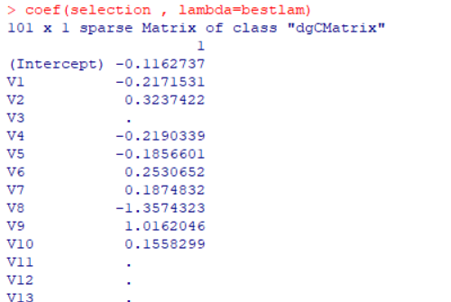
Variable selection results (Cont’d)
9 out of 10 non-zero coefficients in the simulated data, are selected by LASSO penalty function
Advances of Machine Learning in Finance: OLS and LASSO regressions in R
University of Glasgow
2022-2023

Slide 32
Solution path
set.seed(1011)
path<- glmnet(x, y )
plot(path, label=T, xvar='lambda')
To print the solution (or regularization) path of lasso regression, we need to run glmnet function
plot is a generic function to plot the solution path
label is an argument to show the index of each variable at the end of corresponding path
Advances of Machine Learning in Finance: OLS and LASSO regressions in R
University of Glasgow
2022-2023

Slide 33
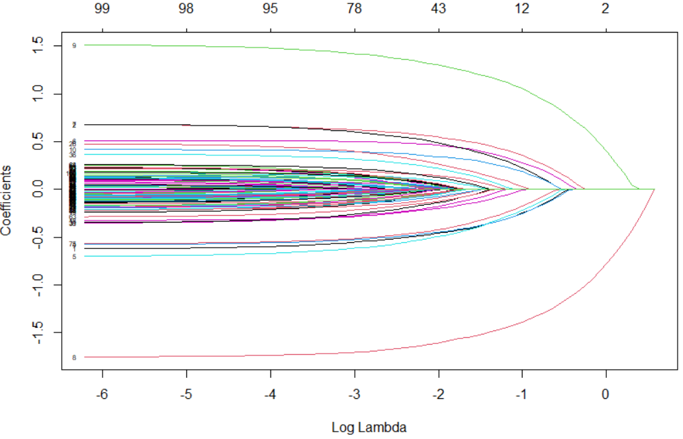
Solution path (Cont’d)
Since variable 8 enters into the model as the first variable, we can say that ‘variable 8’ is the most important variable in predicting y
Second most important variable is ‘variable 9’

Slide 34
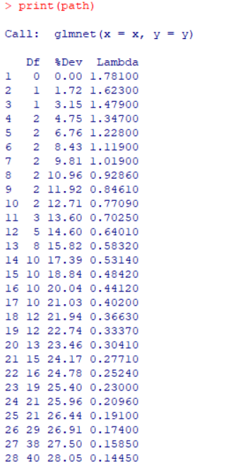
Solution path (Cont’d)
print(path)
To have the sequence of lambdas along with the number of non-zero coefficients (Df) and corresponding percentage of explained deviance (%Dev)
From the results, we find that the two important variables explain a total of 3.1% of the variation in y
Advances of Machine Learning in Finance: OLS and LASSO regressions in R
University of Glasgow
2022-2023

Slide 35
Section 5: Example 2: An application in finance

Slide 36
The dataset
The dataset consists of 2,519 observations from US industrial firms in 2017.
Dependent variable is cash-to-asset ratio
There exist 12 explanatory variables including: firm size, market-to-book ratio, leverage, dividends, R&D, net working capital, capital expenditure, tangible assets, firm age, sales growth, cash flow, and cash flow volatility.
We use LASSO and OLS regression to predict cash ratio and compare their out-of-sample performance
Advances of Machine Learning in Finance: OLS and LASSO regressions in R
University of Glasgow
2022-2023

Slide 37
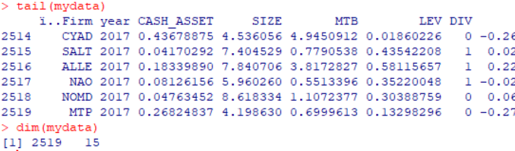
Importing data into R
mydata <- read.csv("C:/cash.csv")
head(mydata)
tail(mydata)
dim(mydata)
We assume that your data is in a csv file
read.csv is a function to read csv files.
Put the path of your file between “ “
Use \\ or / to separate paths.
head and tail are built-in functions to print the first and last rows of a data.frame, respectively.
dim is a function to see the dimensions of a data.frame
Advances of Machine Learning in Finance: OLS and LASSO regressions in R
University of Glasgow
2022-2023

Slide 38
Splitting data
For the purpose of comparison, we need to split the dataset into training and test sets.
The training set is used to fitting the model. The test set is used to prediction.
set.seed (1) is a built-in function to reproduce the results
sample is functions to draw random sample without replacement
nrow gives the number of rows of the dataset
train contains the indexes of observations from the training set
We are using 80% (20%) of data for fitting (predicting)
set.seed (1)
train <- sample (1: nrow(mydata), 0.8*nrow (mydata))
Advances of Machine Learning in Finance: OLS and LASSO regressions in R
University of Glasgow
2022-2023

Slide 39
OLS regression- fitting
As the starting point, we fit the OLS regression using training set:
lm is a built-in function to fit an OLS regression
summary is a generic function to get results of a fitted model
ols.lm<- lm( CASH_ASSET ~ SIZE + MTB + LEV + DIV + CFO + VOL + RD + LIQ + CAPEX + TANG + AGE + SG, data=mydata[train, ])
summary(ols.lm)
Advances of Machine Learning in Finance: OLS and LASSO regressions in R
University of Glasgow
2022-2023

Slide 40
OLS regression- predicting
Here, we predict using OLS regression based on the test data
predict is a built-in function to predict from a fitted model
newdata is the argument that introduces the test data
The second row computes the mean squared errors (MSE) for the OLS regression
pred.ols<- predict(ols.lm, newdata=mydata[ -train, ])
mean((mydata$CASH_ASSET[ -train ] - pred.ols )^2)
Advances of Machine Learning in Finance: OLS and LASSO regressions in R
University of Glasgow
2022-2023

Slide 41
LASSO regression- fitting
In contrast to lm function, we need to introduce independents as matrix and dependent variable as a vector to glmnet function
lam.grid is a sequence of 100 values for lambda. If it is not introduced by user, the function generates a sequence by default.
cv.glmnet selects the best lambda using cross-validation.
The selected lambda is saved in the lambda.min object
x<- as.matrix(mydata[,4:15])
y<- mydata$CASH_ASSET
lam.grid <- 10^ seq (10,-2, length =100)
set.seed(1)
lasso.glmnet<- cv.glmnet(x=x[train,], y=y[train], alpha=1, lambda=grid )
bestlam<- lasso.cv.glmnet$lambda.min
Advances of Machine Learning in Finance: OLS and LASSO regressions in R
University of Glasgow
2022-2023

Slide 42

LASSO regression- predicting
In contrast to lm function, the test data is introduced by newx
The argument s (i.e., size of the penalty) must be set to the selected lambda by CV in the previous step
The second row computes the mean squared errors (MSE) for the LASSO regression
pred.lasso<- predict(lasso.glmnet,
s=bestlam, newx =x[-train ,])
mean((y[ -train ] - pred.lasso)^2)
Advances of Machine Learning in Finance: OLS and LASSO regressions in R
University of Glasgow
2022-2023

Slide 43
References
Efron, B., Hastie, T., Johnstone, I., & Tibshirani, R. (2004). Least angle regression. The Annals of statistics, 32(2), 407-499.
Fan, J., & Li, R. (2001). Variable selection via nonconcave penalized likelihood and its oracle properties. Journal of the American statistical Association, 96(456), 1348-1360.
Friedman, J., Hastie, T., & Tibshirani, R. (2010). Regularization paths for generalized linear models via coordinate descent. Journal of statistical software, 33(1), 1.
Fu, W. J. (1998). Penalized regressions: the bridge versus the lasso. Journal of computational and graphical statistics, 7(3), 397-416.
Hastie, T., Tibshirani, R., & Wainwright, M. (2015). Statistical Learning with Sparsity: The Lasso and Generalizations. CRC Press.
Hoerl, A. E., & Kennard, R. W. (1970). Ridge regression: Biased estimation for nonorthogonal problems. Technometrics, 12(1), 55-67.
James, G., Witten, D., Hastie, T., & Tibshirani, R. (2017). An introduction to statistical learning with applications in R New York: springer.
Tibshirani, R. (1996). Regression shrinkage and selection via the lasso. Journal of the Royal Statistical Society: Series B (Methodological), 58(1), 267-288.
Tibshirani, R., Saunders, M., Rosset, S., Zhu, J., & Knight, K. (2005). Sparsity and smoothness via the fused lasso. Journal of the Royal Statistical Society: Series B (Statistical Methodology), 67(1), 91-108.
Yuan, M., & Lin, Y. (2006). Model selection and estimation in regression with grouped variables. Journal of the Royal Statistical Society: Series B (Statistical Methodology), 68(1), 49-67.
Zou, H. (2006). The adaptive lasso and its oracle properties. Journal of the American statistical association, 101(476), 1418-1429.
Zou, H., & Hastie, T. (2005). Regularization and variable selection via the elastic net. Journal of the royal statistical society: series B (statistical methodology), 67(2), 301-320.
Advances of Machine Learning in Finance: OLS and LASSO regressions in R
University of Glasgow
2022-2023

Slide 44
Contact
If you have any question regarding R programming and financial econometrics, or any suggestion to improve the teaching style, please feel free to contact me through:
hadi.movaghari@glasgow.ac.uk
Advances of Machine Learning in Finance: OLS and LASSO regressions in R
University of Glasgow
2022-2023

